Slide 1
Branch Flow Model relaxations, convexification
Masoud Farivar Steven Low
Computing + Math Sciences
Electrical Engineering
Caltech
May 2012
Notes:
Branch Flow Model: relaxations, convexification, computation
May 24, 2012: Optimization and Control for Smart Grids, 32nd CNLS Annual Conference, Santa Fe, NM (Misha Chertkov)
June 11, 2012: Greenmetrics Workshop, London, UK (Adam Wierman)
June 26, 2012: FERC Conference, Washington D.C. (Dick O’Neil)
July 31, 2012: Energy Day, Chinese University of Hong Kong (Minghua Chen)
Aug 2, 2012: HK University of Science & Technology (Vince Lau, Roger)
Aug 3, 2012: Hong Kong University, EE Dept, HK (Victor Li)
Aug 6, 2012: Tsinghua University, Institute of Theoretical Computer Science, Beijing, China (Raymond Yeung)
Aug 17, 2012: Zhejiang University, EE Dept, Hang Zhou, China (Jiming Chen)
Aug 20, 2012: Shanghai Jiaotong University, EE Dept, Shanghai, China (Xinbing Wang)
Sept 2012: Melbourne University, NICTA, Australia (Pascal Van Hentenryck)
Sept 2012: Swinburne University, Australia (Lachlan Andrew)

Slide 2
Acks and refs
Collaborators
S. Bose, M. Chandy, L. Gan, D. Gayme, J. Lavaei, L. Li
BFM reference
Branch flow model: relaxations and convexification
M. Farivar and S. H. Low
arXiv:1204.4865v2, April 2012
Other references
Zero duality gap in OPF problem
J. Lavaei and S. H. Low
IEEE Trans Power Systems, Feb 2012
QCQP on acyclic graphs with application to power flow
S. Bose, D. Gayme, S. H. Low and M. Chandy
arXiv:1203.5599v1, March 2012

Slide 3
big picture

Slide 4
Global trends
1 Proliferation renewables
Driven by sustainability
Enabled by policy and investment

Slide 5
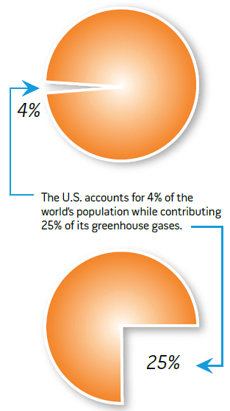
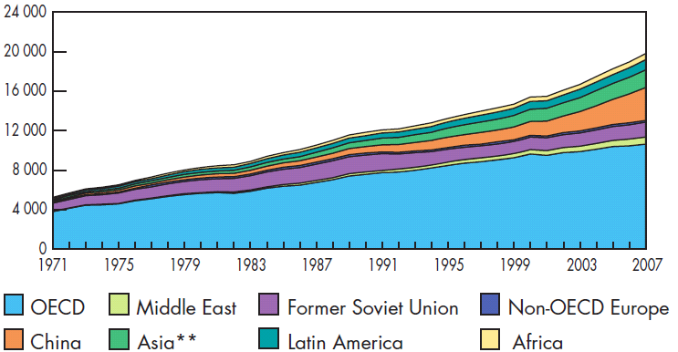
Sustainability challenge
Electricity generation 1971-2007
2007:
19,800 TWh
1973:
6,100 TWh
In 2009, 1.5B people
have no electricity
US CO₂ emission
Elect generation: 40%
Transportation: 20%
Sources: International Energy Agency, 2009
DoE, Smart Grid Intro, 2008

Slide 6
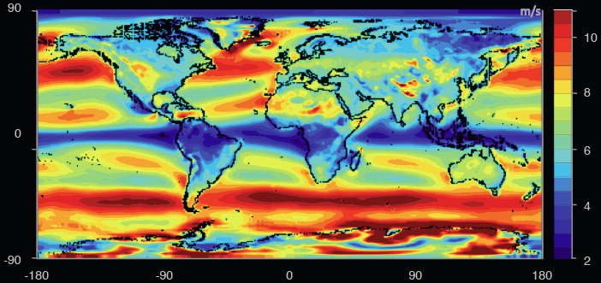
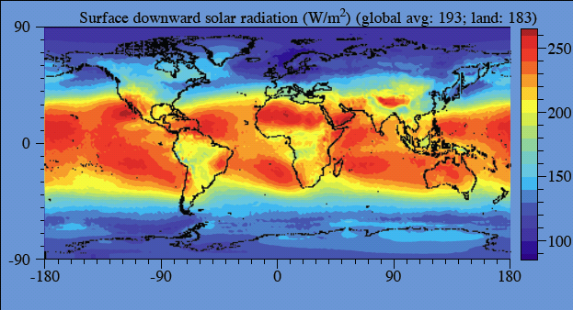
Worldwide
energy demand:
16 TW
electricity demand:
2.2 TW
wind capacity (2009):
159 GW
grid-tied PV capacity (2009):
21 GW
Wind power over land (exc. Antartica)
70 – 170 TW
Source: Renewable Energy
Global Status Report, 2010
Source: M. Jacobson, 2011
Solar power over land
340 TW
Notes:
World wind speed at 100m:
All wind worldwide: 1,700 TW
All wind over land in high-wind areas outside Antartica: 70 – 170 TW
World power (all energy) demand in 2030: 16.9 TW
World surface solar
All solar worldwide: 6,500 TW
All solar over land in high-solar locations: 340 TW
Source: Renewable Energy Global Status Report, Sept 2010:
2009 grid-tied solar PV capacity increase
The world added 7GW of grid-connected PV capacity, to a total of 21 GW
Germany: +3.8 GW to a total of 9.8 GW
Spain: +70MW to a total of 3.4 GW (Govt subsidy expired!)
US: +470MW to a total of 1 GW (CA ~half of increase)
Off-grid capacity: 4 GW
2009 wind capacity increase
Wind power increased the most among all renewables, by 38 GW to a total of 159 GW
US: +10 GW to a total of 35 GW
China: +13.8 GW to a total of 25.8 GW
Germany: +1.9GW to a total of 25.8 GW

Slide 7
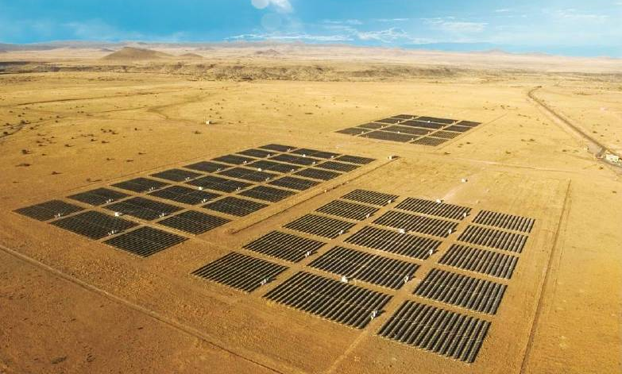
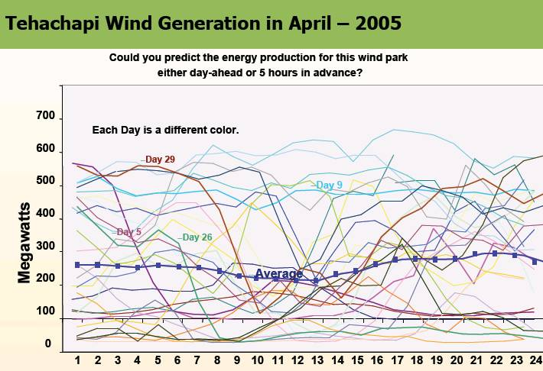
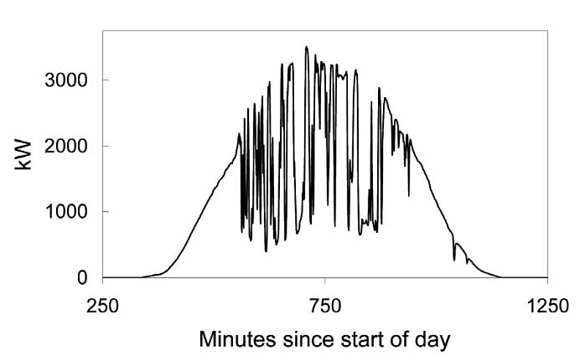
Uncertainty
High Levels of Wind and Solar PV Will Present an Operating Challenge!
Source: Rosa Yang, EPRI

Slide 8
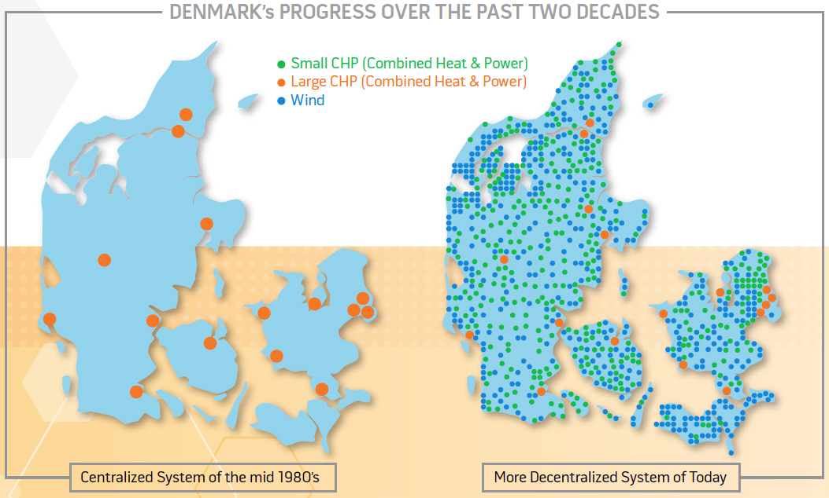
Global trends
1 Proliferation of renewables
Driven by sustainability
Enabled by policy and investment
2 Migration to distributed arch
2-3x generation efficiency
Relief demand on grid capacity

Slide 9
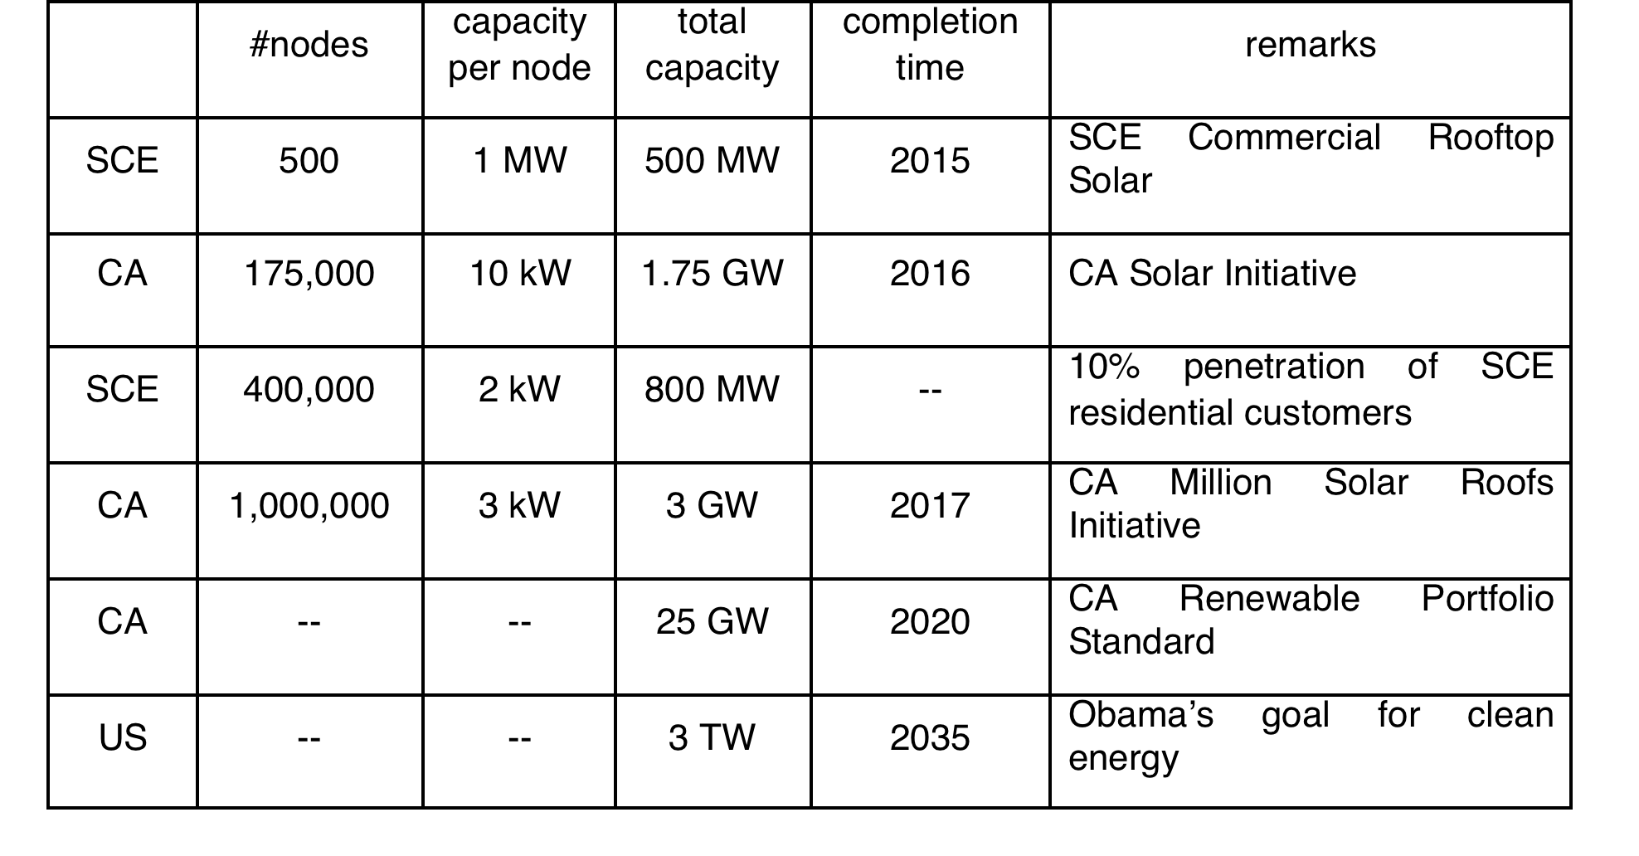
Large active network of DER
DER: PVs, wind turbines, batteries, EVs, DR loads

Slide 10
Large active network of DER
Millions of active endpoints introducing rapid large
random fluctuations
in supply and demand
DER: PVs, wind turbines, EVs, batteries, DR loads

Slide 11
Implications
Current control paradigm works well today
Low uncertainty, few active assets to control
Centralized, open-loop, human-in-loop, worst-case preventive
Schedule supplies to match loads
Future needs
Fast computation to cope with rapid, random, large fluctuations in supply, demand, voltage, freq
Simple algorithms to scale to large networks of active DER
Real-time data for adaptive control, e.g. real-time DR

Slide 12
Key challenges
Nonconvexity
Convex relaxations
Large scale
Distributed algorithms
Uncertainty
Risk-limiting approach

Slide 13
Why is convexity important
Foundation of LMP
Convexity justifies the use of Lagrange multipliers as various prices
Critical for efficient market theory
Efficient computation
Convexity delineates computational efficiency and intractability
A lot rides on (assumed) convexity structure
engineering, economics, regulatory

Slide 14
optimal power flow motivations

Slide 15
Optimal power flow (OPF)
OPF is solved routinely to determine
How much power to generate where
Market operation & pricing
Parameter setting, e.g. taps, VARs
Non-convex and hard to solve
Huge literature since 1962
Common practice: DC power flow (LP)

Slide 16
Optimal power flow (OPF)
Problem formulation
Carpentier 1962
Computational techniques
Dommel & Tinney 1968
Surveys: Huneault et al 1991, Momoh et al 2001, Pandya et al 2008
Bus injection model: SDP relaxation
Bai et al 2008, 2009, Lavaei et al 2010, 2012
Bose et al 2011, Zhang et al 2011, Sojoudi et al 2012
Lesieutre et al 2011
Branch flow model: SOCP relaxation
Baran & Wu 1989, Chiang & Baran 1990, Taylor 2011, Farivar et al 2011

Slide 17
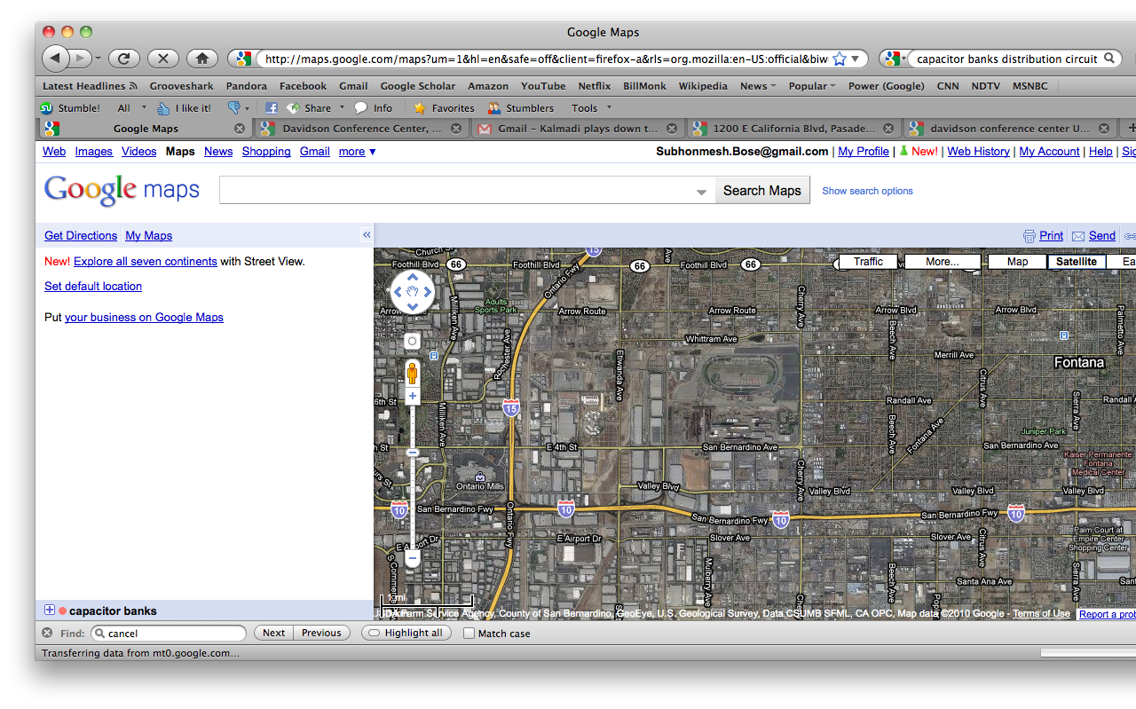
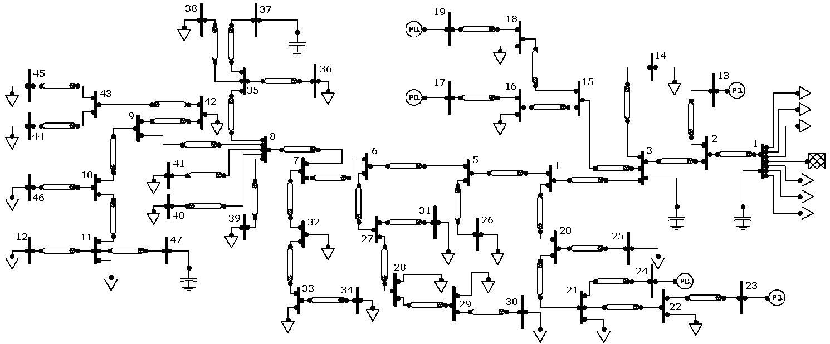
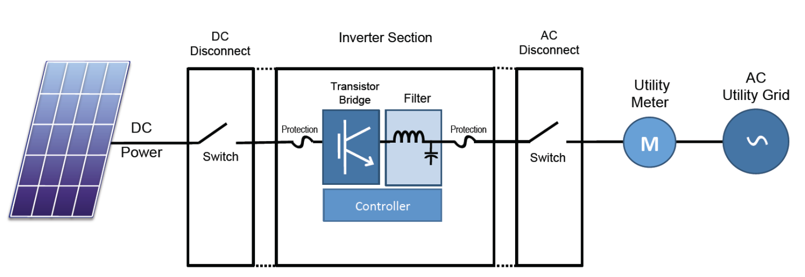
Application: Volt/VAR control
Motivation
Static capacitor control cannot cope with rapid random fluctuations of PVs on distr circuits
Inverter control
Much faster & more frequent
IEEE 1547 does not optimize VAR currently (unity PF)

Slide 18
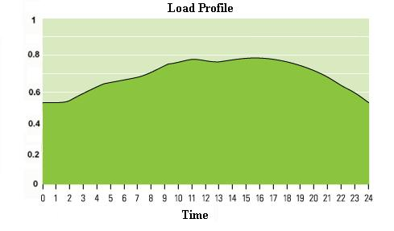
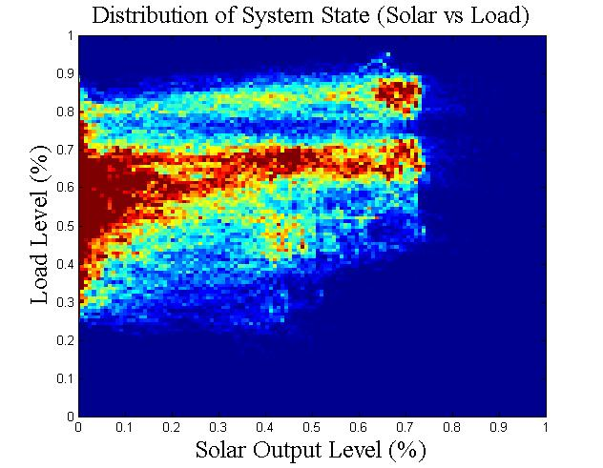
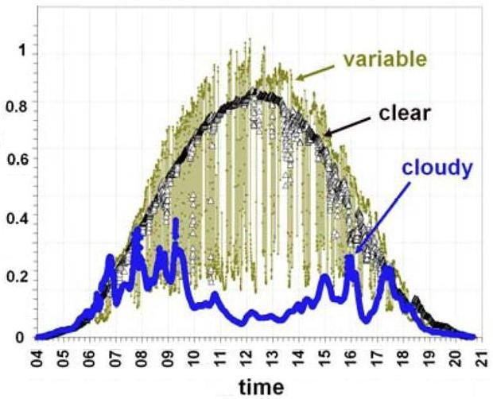
Load and Solar Variation
Empirical distribution
of (load, solar) for Calabash

Slide 19
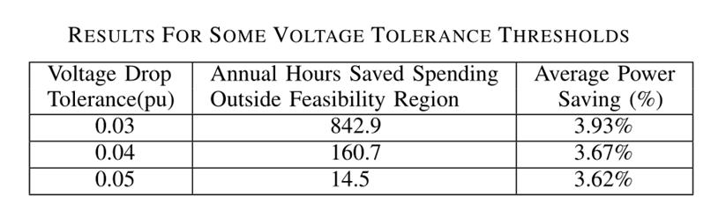
Summary
More reliable operation
Energy savings

Slide 20
theory relaxations and convexification

Slide 21






Outline
Branch flow model and OPF
Solution strategy: two relaxations
Angle relaxation
SOCP relaxation
Convexification for mesh networks
Extensions

Slide 22
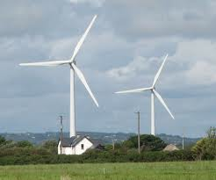
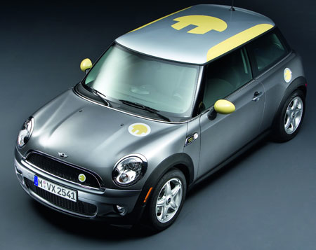
Two models
i
j
k
branch
flow
bus
injection

Slide 23
Two models
i
j
k
branch
current
bus
current

Slide 24
Two models
Equivalent models of Kirchhoff laws
Bus injection model focuses on nodal vars
Branch flow model focuses on branch vars

Slide 25
Two models
What is the model?
What is OPF in the model?
What is the solution strategy?

Slide 26
let’s start with something familiar

Slide 27
Bus injection model
power definition
Kirchhoff law
power balance
admittance matrix:

Slide 28
Bus injection model
power definition
Kirchhoff law
power balance

Slide 29
Bus injection model: OPF
e.g. quadratic gen cost
Kirchhoff law
power balance

Slide 30
Bus injection model: OPF
e.g. quadratic gen cost
Kirchhoff law
power balance

Slide 31
Bus injection model: OPF
e.g. quadratic gen cost
Kirchhoff law
power balance
nonconvex, NP-hard

Slide 32
Bus injection model: OPF
In terms of V:
Key observation [Bai et al 2008]:
OPF = rank constrained SDP

Slide 33
Bus injection model: OPF
convex relaxation: SDP

Slide 34
Bus injection model: relaxation
convex relaxation: SDP
polynomial

Slide 35
Bus injection model: SDR
Non-convex QCQP
Rank-constrained SDP
Relax the rank constraint and solve the SDP
Bai 2008
Does the optimal solution satisfy the rank-constraint?
yes
no
We are done!
Solution may not
be meaningful
Lavaei 2010, 2012
Radial: Bose 2011, Zhang 2011
Sojoudi 2011
Lesiertre 2011

Slide 36
QCQP over tree
QCQP
graph of QCQP
QCQP over tree

Slide 37
QCQP over tree
QCQP
Semidefinite relaxation

Slide 38
QCQP over tree
QCQP
Key condition
Theorem
semidefinite relaxation is exact for
QCQP over tree
S. Bose, D. Gayme, S. H. Low and M. Chandy, March 2012

Slide 39
QCQP over tree
Remarks
condition implies constraint patterns
full AC: inc real and reactive powers
allows constraints on line flows, loss
Key condition
Theorem
semidefinite relaxation is exact for
QCQP over tree
S. Bose, D. Gayme, S. H. Low and M. Chandy, March 2012

Slide 40
OPF over radial networks
full constraints violate key condition

Slide 41
OPF over radial networks
“no lower bounds”
removes these

Slide 42
OPF over radial networks
bounds on constraints
remove these

Slide 43
OPF over radial networks
bounds on constraints
remove these

Slide 44
Bus injection model: summary
OPF = rank constrained SDP
Sufficient conditions for SDP to be exact
Whether a solution is globally optimal is always easily checkable
Mesh: must solve SDP to check
Tree: depends only on constraint pattern or r/x ratios

Slide 45
Two models
What is the model?
What is OPF in the model?
What is the solution strategy?

Slide 46
Branch flow model
power def
Ohm’s law
power balance
sending
end pwr
loss
sending
end pwr

Slide 47
Branch flow model
power def
Ohm’s law
power balance
branch flows

Slide 48
Branch flow model
power def
Ohm’s law
power balance

Slide 49
Branch flow model: OPF
real power loss
CVR (conservation
voltage reduction)
Kirchoff’s Law:
Ohm’s Law:

Slide 50
Branch flow model: OPF

Slide 51
Branch flow model: OPF

Slide 52
Branch flow model: OPF
generation,
VAR control
branch flow
model

Slide 53
Branch flow model: OPF
demand
response
branch flow
model

Slide 54
Outline
Branch flow model and OPF
Solution strategy: two relaxations
Angle relaxation
SOCP relaxation
Convexification for mesh networks
Extensions

Slide 55
Solution strategy
OPF
nonconvex
inverse
projection
for tree
angle
relaxation
OPF-ar
nonconvex
SOCP
relaxation
exact
relaxation
OPF-cr
convex

Slide 56
Angle relaxation
branch flow
model

Slide 57
Angle relaxation
branch flow
model
eliminate
angles
points relaxed
to circles !

Slide 58
Angle relaxation

Slide 59
Angle relaxation

Slide 60
Angle relaxation

Slide 61
Relaxed BF model
relaxed branch flow solutions: satisfy
Baran and Wu 1989
for radial networks

Slide 62
OPF
branch flow
model

Slide 63
OPF

Slide 64
OPF-ar
relax each voltage/current from a
point in complex plane into a circle

Slide 65
OPF-ar
convex objective
linear constraints
quadratic equality
source of
nonconvexity

Slide 66
OPF-cr
→ inequality

Slide 67
OPF-cr
relax to convex hull
(SOCP)

Slide 68
Recap so far …
OPF
nonconvex
inverse
projection
for tree
angle
relaxation
OPF-ar
nonconvex
SOCP
relaxation
exact
relaxation
OPF-cr
convex

Slide 69
OPF-cr is exact relaxation
Theorem
OPF-cr is convex
SOCP when objective is linear
SOCP much simpler than SDP
OPF-cr is exact
optimal of OPF-cr is also optimal for OPF-ar
for mesh as well as radial networks
real & reactive powers, but volt/current mags

Slide 70
Angle recovery
OPF ??
OPF-ar
does there exist s.t.

Slide 71
Angle recovery
Theorem
solution to OPF recoverable from iff
inverse projection exist iff s.t.
incidence matrix;
depends on topology
depends on
OPF-ar solution
Two simple angle recovery algorithms
centralized: explicit formula
decentralized: recursive alg

Slide 72
Angle recovery
Theorem
For radial network:
mesh
tree

Slide 73
Angle recovery
#buses - 1
#lines in T
#lines outside T
Theorem
Inverse projection exist iff
Unique inverse given by
For radial network:

Slide 74
OPF solution
Solve OPF-cr
SOCP
radial
Recover angles
explicit formula
distributed alg
OPF solution

Slide 75
OPF solution
angle recovery
condition holds?
Solve OPF-cr
mesh
Y
radial
N
???
Recover angles
OPF solution

Slide 76
Outline
Branch flow model and OPF
Solution strategy: two relaxations
Angle relaxation
SOCP relaxation
Convexification for mesh networks
Extensions

Slide 77
Recap: solution strategy
OPF
nonconvex
inverse
projection
for tree
angle
relaxation
??
OPF-ar
nonconvex
SOCP
relaxation
exact
relaxation
OPF-cr
convex

Slide 78
Phase shifter
ideal phase shifter

Slide 79
Convexification of mesh networks
OPF
OPF-ar
OPF-ps
optimize over phase shifters as well
Theorem
Need phase shifters only
outside spanning tree

Slide 80
Angle recovery with PS
Theorem
Inverse projection always exists
Unique inverse given by
Don’t need PS in spanning tree

Slide 81
OPF solution
angle recovery
condition holds?
Solve OPF-cr
mesh
Y
radial
N
Optimize phase
shifters
Recover angles
explicit formula
distributed alg
OPF solution

Slide 82
Examples
With PS

Slide 83
Examples
With PS

Slide 84
Key message
Radial networks computationally simple
Exploit tree graph & convex relaxation
Real-time scalable control promising
Mesh networks can be convexified
Design for simplicity
Need few (?) phase shifters (sparse topology)

Slide 85
Outline
Branch flow model and OPF
Solution strategy: two relaxations
Angle relaxation
SOCP relaxation
Convexification for mesh networks
Extensions

Slide 86
Extension: equivalence
Theorem
BI and BF model are equivalent
(there is a bijection between and )
Work in progress with Subhonmesh Bose, Mani Chandy

Slide 87
Extension: equivalence
SDR
SOCP
Theorem: radial networks
in SOCP W in SDR
satisfies angle cond W has rank 1
Work in progress with Subhonmesh Bose, Mani Chandy

Slide 88
Extension: distributed solution
i
local load, generation
local Lagrange multipliers
highly parallelizable !
Local algorithm at bus j
update local variables based on Lagrange multipliers from children
send Lagrange multipliers to parents
Work in progress with Lina Li, Lingwen Gan, Caltech

Slide 89
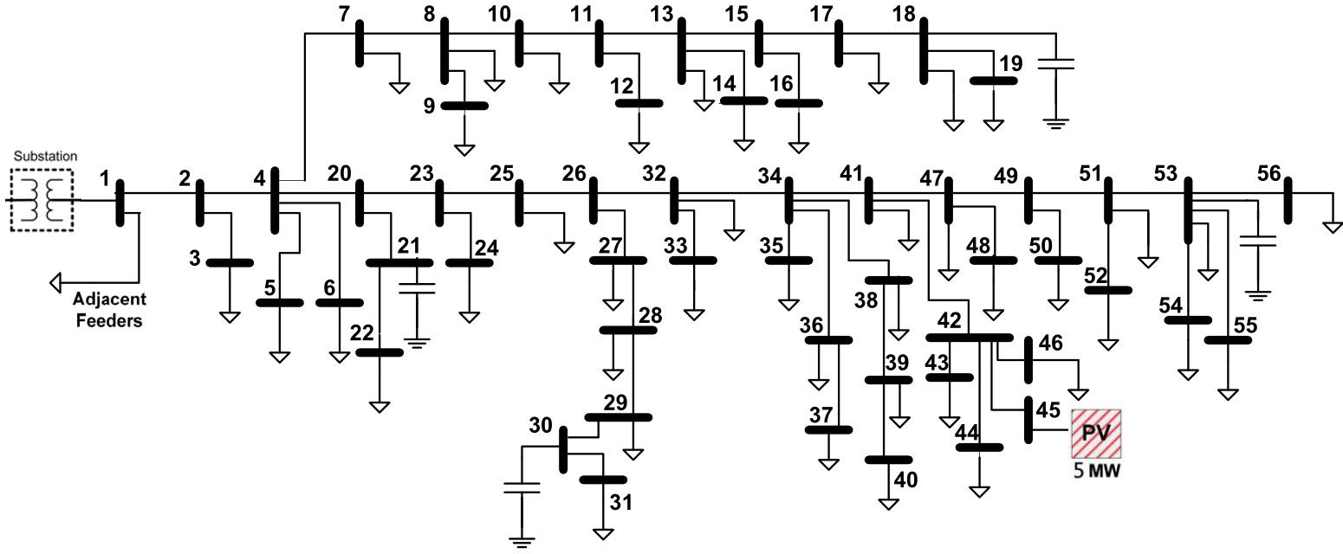
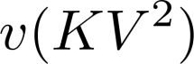
Extension: distributed solution
SCE distribution circuit
0.3
p (MW)
0.2
0.1
0
3
P (MW)
2
1
0
155
150
145
140
45
3
P0 (MW)
2.5
2
1.5
0
1000
2000
3000
4000
Theorem
Distributed algorithm converges
to global optimal for radial networks
to global optimal for convexified mesh networks
to approximate/optimal for general mesh networks
Work in progress with Lina Li, Lingwen Gan, Caltech

